Slide 1


CHM 103 ORGANIC CHEMSTRY I
Department of Chemical Sciences
Faculty of Science and Technology
Bingham University, Karu
Course Lecturer: Joseph C. Oguegbulu
Joseph.oguegbulu@binghamuni.edu.ng

Slide 2

COURSE CONTENT
PART A – Mr. Joseph
Introduction. History, classifications 0.5 week
Carbon: Bonding in organic compounds, structure 0.5 week
Functional groups 0.5 week
IUPAC nomenclature 1 week
Isomerism – Structural & Stereo-isomerism 2 weeks
Hybridisation – Resonance effects & others 2 weeks
PART B – Assoc. Prof. Okoli
Alkanes, Alkenes, Alkynes
Alkyl halides, Alkanols
Carbonyl compounds: Alkanals and Alkanones.

Slide 3
CHM 103 ORGANIC CHEMSTRY I
Department of Chemical Sciences
Faculty of Science and Technology
Bingham University, Karu
Course Lecturer: Joseph C. Oguegbulu
Joseph.oguegbulu@binghamuni.edu.ng

Slide 4
LECTURE III
WRITING CHEMICAL FORMULARS
GENERAL FORMULAS
MOLECULAR FORMULAS
STRUCTURAL FORMULAS
EXPRESSED
CONDENSED
SKELETAL

Slide 5

OBJECTIVES: At the end, you should be able to…
Differentiate between the different formulas of organic compounds
Draw the expressed, condensed & skeletal formulas of simple and semi-complex organic compounds
Show the classifications of organic compounds

Slide 6
FORMULARS OF COMPOUNDS
General formula e.g. C₂H₆O
Empirical Formula e.g. C₂H₆O
Molecular Formula e.g. C₂H₅OH
Structural Formula e.g. CH₃CH₂OH
Expressed
Condensed
Skeletal

Slide 7
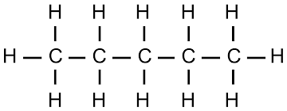
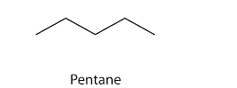
STRUCTURAL FORMULARS
Expressed
All atoms are written out
All bonds shown
Condensed CH₃CH₂CH₂CH₂CH₃
All atoms are written out
Bonds not shown unless double, triple
Skeletal
Carbons and Hydrogens not drawn
Lines drawn at angle 120º

Slide 8
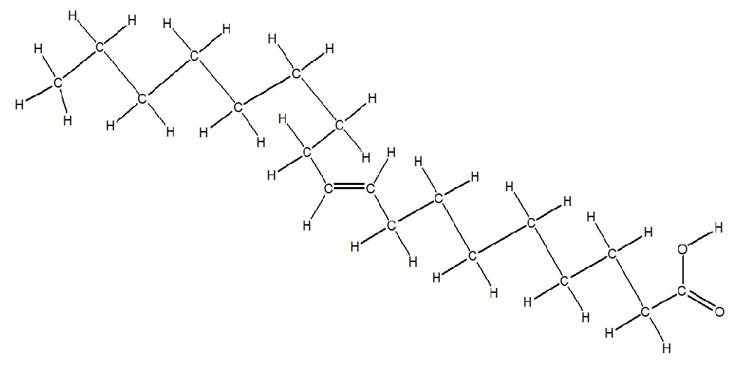
DRAWING CONDENSED FORMULARS
EXAMPLE:
CH₃(CH₂)₇CH=CH(CH₂)₇COOH
condenses to………………………
HOW?
Solution: Start by drawing out the CH₃. The (CH₂)₇ represents a repeating unit, meaning you must draw seven CH₂‘s one after another, which are bonded to a CH which is bonded (double bond) to another CH, and then draw out another seven CH₂‘s. The COOH represent a carboxylic acid, which means you have a C=O connected to an O-H. Always double check your structure to ensure every carbon is making FOUR (4) bonds. When you do this, you will see why the two CH needed to be double bonded.

Slide 9
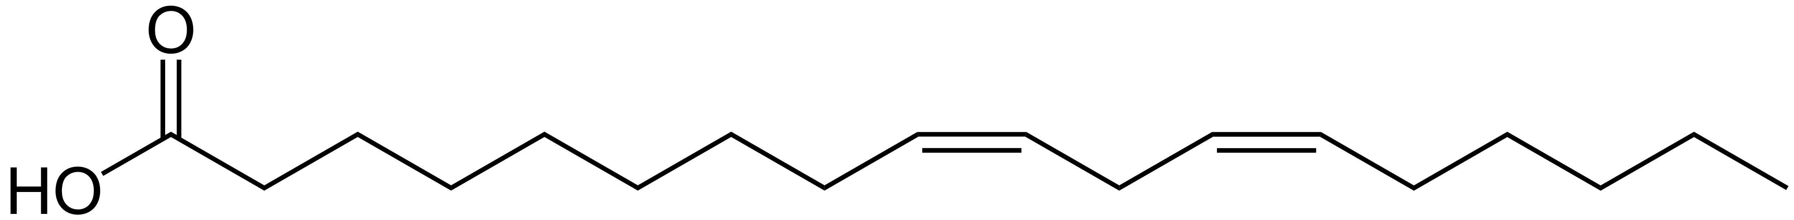
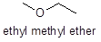
DRAWING SKELETAL FORMULAS
C and H not shown
H is only shown when; -NH, -OH, -SH, etc
Other elements, O,S,N, etc MUST be shown
Lines represent bonds
Drawn at 120º for convention
End of line represent C (e.g. CH₃)
Edges represent C (e.g CH₂)
Octet rule always obeyed
E.g. C must always have 4 bonds, O = 2 bonds, N= 3 bonds, H= 1 Bond, etc
When you don’t see 4 bonds on C, it means H is attached but not shown as usual
Or a double or triple bond is present

Slide 10
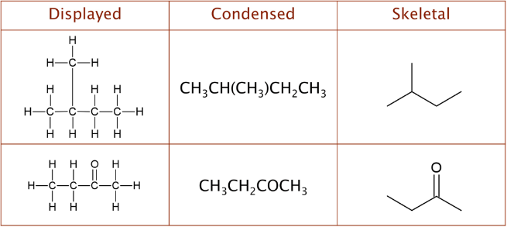
DIFFERENT STRUCTURAL FORMULAS
See how same compound can be expressed in all three ways

Slide 11
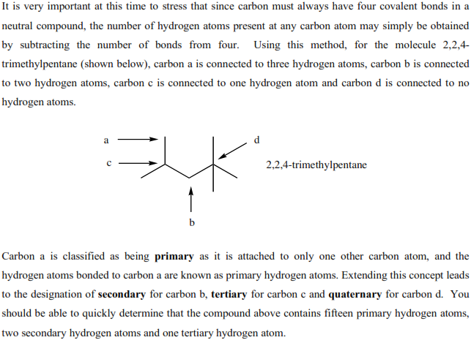
DIFFERENT STRUCTURAL FORMULAS

Slide 12
TUTORIAL 1
Q1: Draw the CONDENSED and SKELETAL formulas of…
1.
2.

Slide 13
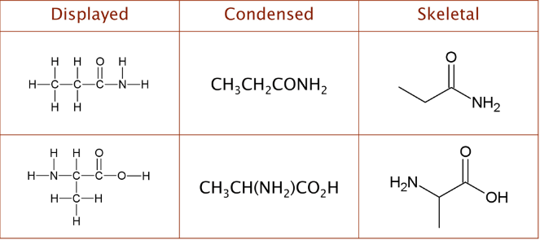
TUTORIAL 1
Q1: ANSWER
1.
2.

Slide 14
TUTORIAL 1
Here are some more cute YouTube videos to help you with you with drawing skeletal formulas. Please click the links and watch carefully.
https://www.youtube.com/watch?v=RP6AS7XVIC8 (most recommended)
https://www.youtube.com/watch?v=TcvR_-d0wCU
https://www.youtube.com/watch?v=RP6AS7XVIC8
https://www.youtube.com/watch?v=U58E0xvVAig
https://www.youtube.com/watch?v=d2pBajWN3DI

Slide 15
TUTORIAL 1
Q1: Convert the following skeletal structures into expressed formulas
Q1: Convert the following condensed formuas to skeletal formulas
CH₃CH₂CH₂CH(CH₃)CH(CH₃)₂
CH₃CHFBr

Slide 16


Slide 17
CHM 103 ORGANIC CHEMSTRY I
Department of Chemical Sciences
Faculty of Science and Technology
Bingham University, Karu
Course Lecturer: Joseph C. Oguegbulu

Slide 18
LECTURE IV
HOMOLOGOUS SERIES
IDENTIFICATION OF FUNCTIONAL GROUPS
IUPAC NUMENCLATURE OF ORGANIC COMPOUNDS

Slide 19
OBJECTIVES: At the end, you should be able to…
Appreciate the gradual variations in properties across a homolgs. series
Identify functional groups from their general forml. or molecular formula
Show how 2name them as prefix/suffix
Understand the rules governing the naming of cmpds & apply them
Be able to convert drawn structures into IUPAC names and vice verse

Slide 20
HOMOLOGOUS SERIES
Family of compounds with same functional group where…
Members (homologues) differ by a methylene group (i.e. CH₂)
They have same empirical formula & same general formula
Hence similar chemical properties
With gradual variations in the properties as series progresses
Eg Alkenes (C_{n}H_{2n}): Members CH₄, C₂H₆, C₃H₈ all differ by CH₂
Eg2: Alcohols (C_{n}H_{2n+2}O) (R-OH). Members; CH₃OH, C₂H₅OH
Propene
Butene
Pentene
Methanol
Ethanol

Slide 21
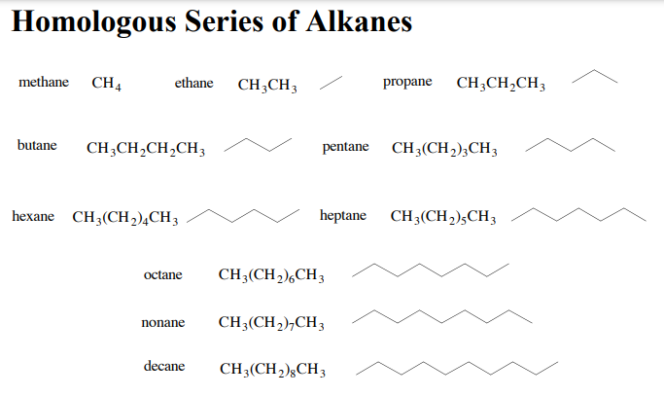
Perhaps the easiest example would be…

Slide 22
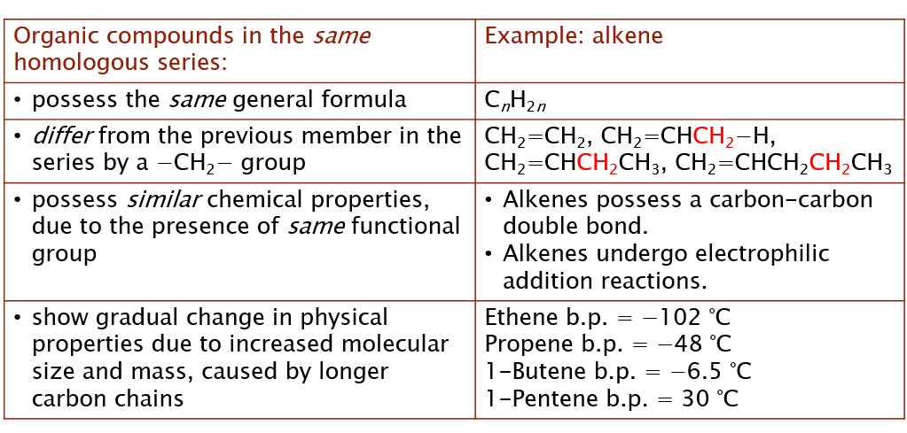
HOMOLOGOUS SERIES: Characteristics

Slide 23
HOMOLOGOUS SERIES
Q6
Show five (5) homologues of the compound below?
Don’t skip

Slide 24

QUESTIONS???

Slide 25
FUNCTIONAL GROUPS
A functional group is a group of atoms bound together in a particular manner which…
Are responsible for the characteristic properties of the compound
Determines the kind of chemical reactions a compound undergoes
e.g carboxylic acid (R-COOH), alcohol (R-OH), amine (R-NH₂).

Slide 26
IDENTIFICATION OF FUNCTIONAL GROUPS
It is important for the student to be able to recognise/ identify functional groups
THE MORE YOU LOOK THE MORE YOU SEE!!!
You must be able to tell the following about them…
Name e.g. Alcohol
General formula e.g. R-OH
Examples e.g. Ethanol
Structural formula e.g CH₃CH₂OH
Naming as Suffix -ol
Naming as Prefix Hydroxy

Slide 27
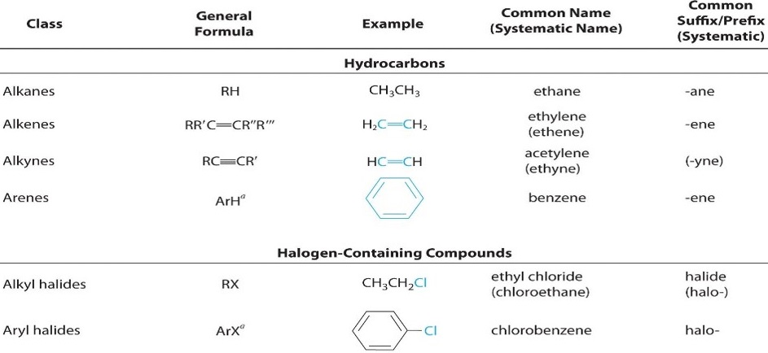
IDENTIFICATION OF FUNCTIONAL GROUPS
a

Slide 28
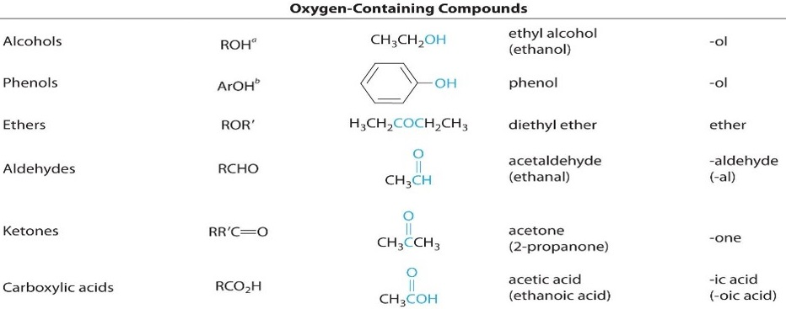
IDENTIFICATION OF FUNCTIONAL GROUPS
a

Slide 29
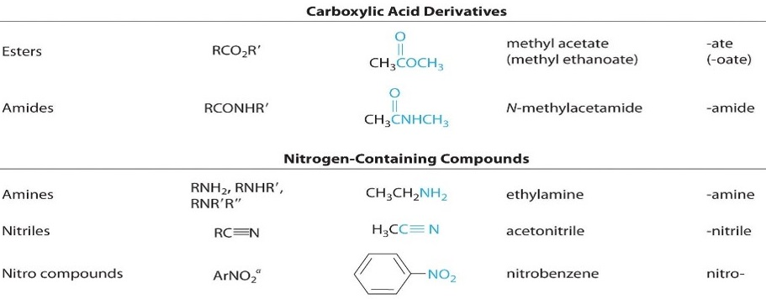
IDENTIFICATION OF FUNCTIONAL GROUPS
a

Slide 30
TUTORIAL III: FUNCT. GRP IDENTIFICATION
Q7
Identify the following functional groups
Note: Compounds may have more than one functional group
An AMINO ALCOHOL
OR
A HYDROXY AMINE

Slide 31
TUTORIAL III: FUNCT. GRP IDENTIFICATION
Q7: Answers:
Alcohol
Amide (NOT AMINE!!)
Alkyne
Carboxylic acid
Ketone
Aldehyde
Amine

Slide 32
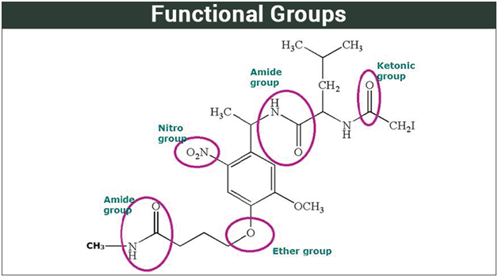

Slide 33
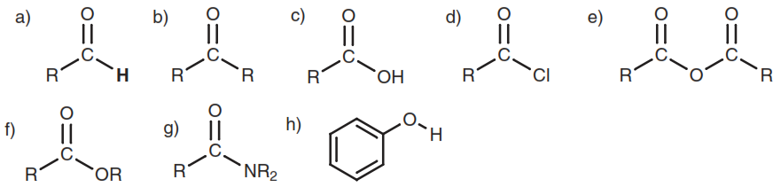
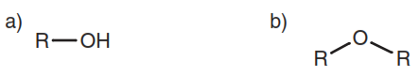
IDENTIFICATION OF FUNCTIONAL GROUPS
Functional groups containing Oxygen (double &single bonds)

Slide 34
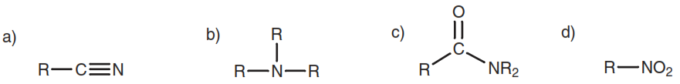
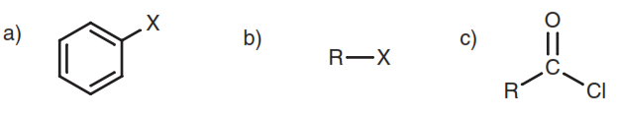
IDENTIFICATION OF FUNCTIONAL GROUPS
Functional groups containing Nitrogen
Functional groups containing Halides (Cl, Br, I, F, etc.)

Slide 35
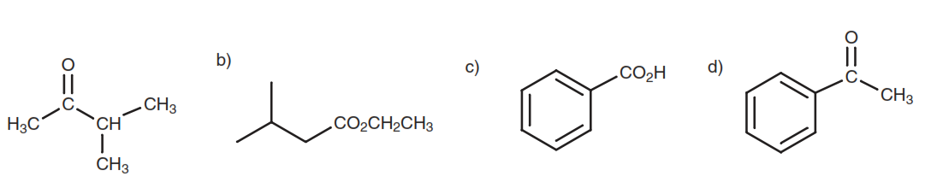
IDENTIFICATION OF FUNCTIONAL GROUPS
Aromatic vs Aliphatic Functional groups
As you can see, a and b are aliphatic groups while c and d are aromatic groups

Slide 36
QUESTIONS???

Slide 37
IUPAC NUMENCLATURE
IUPAC: International Union of Pure and Applied Chemists
Unified system for naming organic compounds (SYSTEMIC)
OLD NAMES were not good enough bc there was no system
E.g. ethylene, iso-butane, acetaldehyde, formaldehyde, ether
Wit.h IUPAC system, every cmpd can have a distinct name
Eg Ethene, 2-methylpropane, ethanol, methanol, diethyl ether, etc
Some cmpds are still commonly known by their Old names,
E.g. Acetone (IUPAC Name: Propan-2-one)

Slide 38
IUPAC NUMENCLATURE
Learning IUPAC rules, you should be able to…
Determine systematic name of a cmpd from its structural formula
Identify compounds by their systemic names
Draw the structure of a compound from its systematic name

Slide 39
IUPAC NUMENCLATURE: Rules
Identify the parent chain (longest connected carbons)
Choose the principal functional group
Identify the side chains (substituents)&other funct groups
Number everything correctly (locants)
Combine the names... (Remember to use correct punctuations)

Slide 40
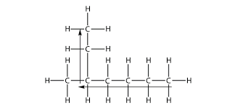
IUPAC NUMENCLATURE: Rule 1
Identify the parent chain
Choose the longest carbon chain…carefully
This will be the name of the root part of the name,
Eth- == 2 Carbons, prop- == 3, but- == 4, hept- == 7, etc
Cyclic aliphatics are simply named with the term cyclo-
E.g. cyclohexane, cyclopropane, etc
Note: Longest carbon chain must NOT be the horizontal one

Slide 41
IUPAC NUMENCLATURE: Rule 2
2. Choose the principal functional group
If there are multiple functional groups, there is an order of priority for choosing the main one
E.g. Carboxilic acid > Ester > Amide > Aldehyde = Ketone > Alcohol = Amine > Alkene/yne > Halide > Nitro, etc
The principal functional group will be named as SUFFIX
E.g. CARBOXILIC ACID is named…. –oic acid
Alkanol === -ol Alkanal == -al
Ether === ether Alkanone == -one etc

Slide 42
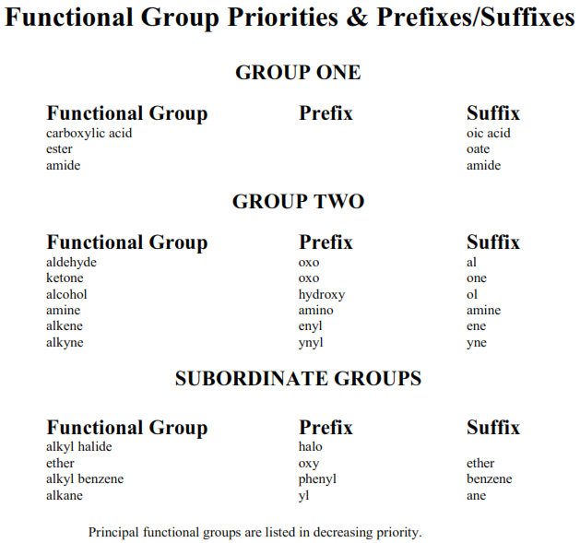
IUPAC NUMENCLATURE: Rule 2

Slide 43
IUPAC NUMENCLATURE: Rule 3
3. Identify the side chains (Substituents) &other funct groups
They will be named as prefixes
When combining them, they will be placed in alphabetical order
If there are more than one of the same, use di, tri, tetra…etc
E.g. dimethyl-, trihydroxy-, tetrachloro-, etc
The di, tri, tetra used are not considered in the alphabtcl. order
Identify the multiple bonds, ‘ene’ or ‘yne’

Slide 44
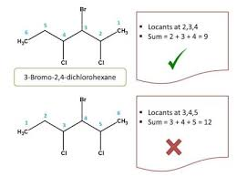
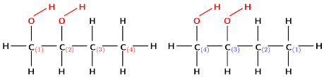
IUPAC NUMENCLATURE: Rule 4
4. Number correctly (locants)
Number the parent chain in such a way that the principal functional group is at lowest locant (number)
Use that numbering as reference to know positions of substituents
If there are long side chains, number them too
If alternatives exist, choose numbering that gives the least sum

Slide 45
IUPAC NUMENCLATURE: Step 5
5. Combine the different parts of the name
Prefix(es) --------- Root or Parent -------- Ending or Suffix
e.g.
Bromo -------- methan --------- ol
OR Hydroxy -------- methane -------- bromide

Slide 46
IUPAC NUMENCLATURE: Punctuation Rules
Hyphens are placed between numbers and words
Commas are used between numbers, ALWAYS!

Slide 47
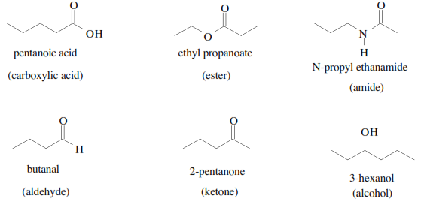
IUPAC NUMENCLATURE: Examples

Slide 48
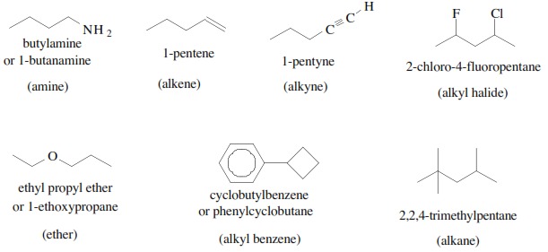
IUPAC NUMENCLATURE: Examples

Slide 49
IUPAC NUMENCLATURE: Tutorials
Try your hands on as many of the ‘Numenclature’ questions in this link as you can:
https://www.chem.tamu.edu/class/fyp/mcquest/ch27.html
Please DO NOT SKIP

